Slide 1
Software Specifications
Neeraj Jain and Rahul Gupta

Slide 2
Objective
What is Software Specification
Different types of Specification
How to design a good specification

Slide 3
What is Software Specification
In order to build anything one needs to know its specifications.
A software specification may have multiple aspects like requirements specification, functional design specification, technical design specification and more.
This lecture focuses on specification for program units like a class or a method.
A specification for a program unit is like a contract, saying what it can count on from the rest of the program, and what it’s expected to do in return.
Notes:
In order to build anything, say a house or a car or a software application, one needs to know its specifications.

Slide 4
Specification for a Method - Example
Example specification for the Add method of BigInteger class in Java (Specification from the API documentation)
Add
public BigInteger add(BigInteger val)
Returns a BigInteger whose value is (this + val).
Parameters:
val - value to be added to this BigInteger.
Returns:
this + val

Slide 5
Behavioral Equivalence
static int findFirst(int[] arr, int val) { for (int i = 0; i < arr.length; i++) { if (arr[i] == val) return i; } return arr.length; } static int findLast(int[] arr, int val) { for (int i = arr.length -1 ; i >= 0; i--) { if (arr[i] == val) return i; } return -1; }

Slide 6
Method Specification Structure
A specification of a method consists of two clauses:
a precondition, indicated by the keyword requires
a postcondition, indicated by the keyword effects
static int find(int[] arr, int val) requires: val occurs exactly once in arr effects: returns index i such that arr[i] = val

Slide 7
Specifications in Java
/** * Find a value in an array. * @param arr array to search, requires that val occurs exactly once * in arr * @param val value to search for * @return index i such that arr[i] = val */ static int find(int[] arr, int val)

Slide 8
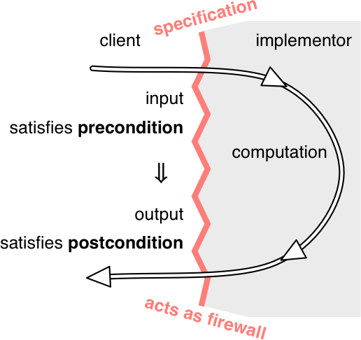
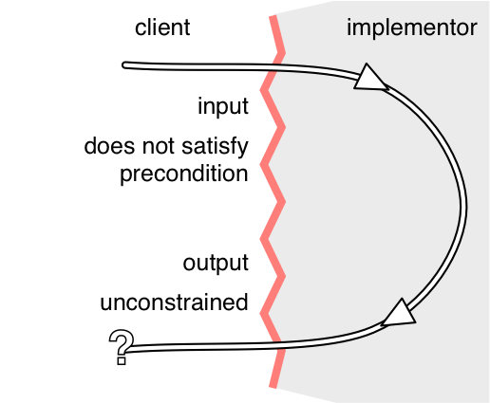

Slide 9
Exceptions
A method's signature — its name, parameter types, return type — is a core part of its specification, and the signature may also include exceptions that the method may trigger.

Slide 10
LocalDate lookup(String name) throws NotFoundException { ... if ( ...not found... ) throw new NotFoundException(); …
Caller
BirthdayBook birthdays = ... try { LocalDate birthdate = birthdays.lookup("Alyssa"); // we know Alyssa's birthday } catch (NotFoundException nfe) { // her birthday was not in the birthday book }

Slide 11
Deterministic vs. Underdetermined Specs
Deterministic spec define only a single possible output for a given input, while underdetermined allow the implementer to choose from a set of legal outputs?

Slide 12
Declarative vs. Operational Spec
Operational specifications give a series of steps that the method performs; pseudocode descriptions are operational.
Declarative specifications don't give details of intermediate steps. Instead, they just give properties of the final outcome and how it's related to the initial state.

Slide 13
Stronger vs. Weaker Spec
A specification S2 is stronger than or equal to a specification S1 if
S2's precondition is weaker than or equal to S1's, and
S2's postcondition is stronger than or equal to S1's for the states that satisfy S1's precondition.

Slide 14
Designing of Good Specifications
The specification should be coherent
The results of a call should be informative
The specification should be strong enough
The specification should also be weak enough
The specification should use abstract types where possible

Slide 15
Summary
How specification acts as a crucial firewall between implementer and client — both between people (or the same person at different times) and between code.

Slide 16
Assignment

